Slide 1

50.039 Theory and Practice of Deep Learning W1-S1 Introduction and Machine Learning Reminders
Matthieu De Mari

Slide 2

A quick word about instructors
Matthieu (Matt) De Mari
Lecturer at SUTD (Python, Deep Learning, AI, and more)
Information Systems Technology and Design (ISTD) pillar/faculty
PhD from CentraleSupelec (France)
Email: matthieu_demari@sutd.edu.sg
Office @ SUTD: 2.401.07

Slide 3
Objectives of 50.039 DL
Introduce the technical aspects related to the implementation of Deep Neural Networks from scratch.
Teach the students about the most popular framework for implementing Deep Neural Networks (as of Jan 2023): PyTorch.
Discuss the mathematical foundations and intuitions behind the Deep Learning framework, layers and some techniques.
Give the students a global overview of the advanced techniques related to Deep Learning and Deep Neural Networks.
Describe examples of practical applications of Deep Learning, showing how some key AIs were implemented using Deep Learning.

Slide 4
Objectives of 50.039 DL
Eventually, assemble all concepts and tricks of the trade discussed in this course to produce big architecture models that are close to the current state-of-the-art ones (e.g. ChatGPT, Dall-E, etc.).
Discuss ethical aspects related to some of the concepts discussed.
Give students an understanding of the current state of research in the Deep Learning community, and more specifically pointers as to where the most up-to-date information can be found.
This includes tracking big names in the field, identifying key scientific papers that have changed the field, but also newsletters, websites or magazines that disclose information in layman terms.

Slide 5
Skills needed for this course
Must-have CS: Python, Numpy, Matplotlib.
Must-have Math: Linear Algebra, multiple variables calculus, derivatives, optimization probability and statistics.
Good-to-have CS: Machine Learning, Data Processing, Scipy, Sklearn.
Good-to-have Math: Graph Theory, Game theory.
Need to revise? Time to check your 10.014 CTD, 10.013 M&A, 10.018 MS&S, 10.022 MU, 10.020 DDW, and 50.007 ML!

Slide 6
The way I teach things
An expert is not someone who
Undertook a 6h-long online course,
Implements Neural Networks using basic layers (Linear, Conv, and that is it),
Using a random framework he does not understand (or autoML!),
and is happy to get an 80% accuracy on a simple dataset like MNIST.
An expert is someone who
Understands how Neural Network operate and the mathematical intuition behind typical (advanced) operations,
Understands how the frameworks have been built and what they do behind the scene.
Someone who knows how to stay up to date when it comes to AI.

Slide 7
The way I teach things
One topic per week (or so) and hopefully, we will cover all the important concepts and important directions of DL these days.
Lectures slides uploaded the day before, and supporting notebooks.
Mathematical aspects discussed in class (behind the scene of Neural Networks/Deep Learning).
Made a choice: providing lots of code to demonstrate concepts, but need you to play with them autonomously to explore concepts!
Extra reading, for curiosity (supporting papers, articles, etc.) and suggestions of pointers to follow to stay up to date.
Suggestions for continuing your learning, after this course.

Slide 8
Syllabus
Week 1: Introduction to course, some ML jargon reminders, linear and polynomial regression, generalization, ridge regression and regularization, overfitting/underfitting, logistic regression, neurons objects and how they relate to biology, our first shallow neural network, gradient descent reminders, training and testing procedure.
Week 2: Introduction to PyTorch framework, tensors and dataloaders, implementing a shallow neural network in PyTorch, backpropagation in PyTorch with AutoGrad, advanced optimizers, multi-label classification with shallow neural networks, moving from shallow to deep neural networks.

Slide 9
Syllabus
Week 3: Guided project and good practices for Deep Learning projects (train/test/dev, bias/variance, advanced regularization, dropout, normalizing inputs/outputs/layers, trainer functions, savers/loader functions for reproducibility and transfer learning).
Week 4: The image data type, image processing techniques and typical computer vision operations, the convolution operation and layers, Convolutional Neural Networks, advanced CNNs and SotA. Preparing transition to the 50.035 Computer Vision course.

Slide 10
Syllabus
Week 5: Sequential data (times series, text, etc.), vanilla Recurrent Neural Networks, Gated Recurrent Units, Long-Short Term Memory cells, advanced RNN networks, mixing models for advanced architectures and project announcement.
Week 6: Adversarial machine learning, attacking a Neural Network with basic gradient-based attacks, fundamental limits of Neural Networks, defense mechanisms and state-of-the-art of some advanced attacks techniques. MidTerm exam (based on W1-5).

Slide 11
Syllabus
Week 8: The embedding problem, more advanced concepts on RNNs, introduction to Natural Language Processing (NLP) and Word Embeddings for NLP, brief state-of-the-art on NLP, attention and transformers architectures. Preparing transition to the 50.040 Natural Language Processing course.
Week 9: Quick introduction to Graph Theory and typical graph datasets and problems, basics of Graph Convolutional Networks, brief state-of-the-art of advanced Graph Convolutional Networks.

Slide 12
Syllabus
Week 10: Generative Models, Autoencoders and Variational Autoencoders, Generative Adversarial Networks (GANs), Advanced concepts on Generative Adversarial Networks, Practice on GANs.
Week 11: Brief introduction to reinforcement learning, and state-action-rewards systems, multi-armed bandit problem and the exploration/exploitation trade-off, Q-learning and Deep Q-Learning. Brief state-of-the-art discussion about further works in Reinforcement Learning.

Slide 13
Syllabus
Week 12: Explainability/Interpretability and open questions in research about Neural Networks. Deep belief models and diffusion models. What will be the next revolution in AI? (a word on ChatGPT, Dall-E, etc.). Closing and future directions for studying Deep Learning.
Week 13: Recap. Project presentations and guest conferences (TBA).
Week 14: Final exam (probably W1-13).

Slide 14
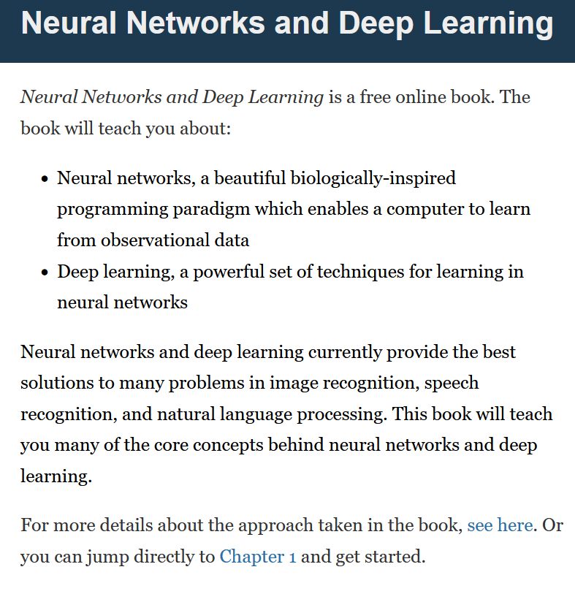
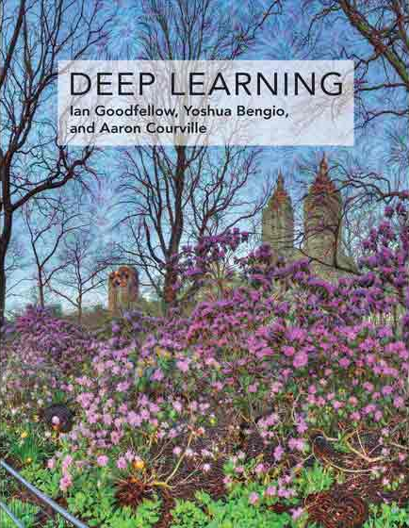

Supporting Textbooks
Supporting textbooks, for your curiosity (not needed to understand this course).
Michael A. Nielsen, “Neural networks and deep learning”, 2015. (http://neuralnetworksanddeeplearning.com/)
Ian Goodfellow, Yoshua Bengio and Aaron Courville, “Deep learning”, 2016. (https://www.deeplearningbook.org/)
Stevens et al., “Deep Learning with PyTorch”, 2020. (https://www.manning.com/books/deep-learning-with-pytorch)

Slide 15
Evaluation and grading
Homeworks (24%): Given on Weeks 2, 5, 8, 10. Usually come in the form of a Jupyter Notebook, containing explanations, code snippets and questions. Submissions on eDimension, two weeks later or so, as a small PDF report containing code, figures and answers to questions. When time allows, debrief of homeworks in class.
MidTerm Exam (20%): Given on Week 6, March 1st 2023. Theoretical, paper exam, notions of Week 1-5 to be tested. More details about venue and exam details to be announced closer to the exam date.

Slide 16
Evaluation and grading
Final Exam (20%): Given on Week 14, April 26th 2023. Theoretical, paper exam, notions of Week 1-13 to be tested. More details about venue and exam details to be announced.
Project (29%): Groups of 2-3 students. Submission for project (code, report, presentation) expected on Week 13. Problem statement to be freely decided by students, as long as it matches a list of given requirements. We will have a guided demo project on Week 3, more details about the project will be given on Week 5.
Participation (5%): to my discretion.
Student Feedback Survey (2%): the usual.

Slide 17



Technical pre-requisites
Install Python 3, if you have not done so already (this course does not cover C++/Java).
Libraries needed (maybe more based on projects/homeworks): numpy, matplotlib, scipy, sklearn, networkx, pillow, gym.
Jupyter notebooks for demos of code, along with the slides.
In doubt, you can always use Google Colab to run the codes.

Slide 18

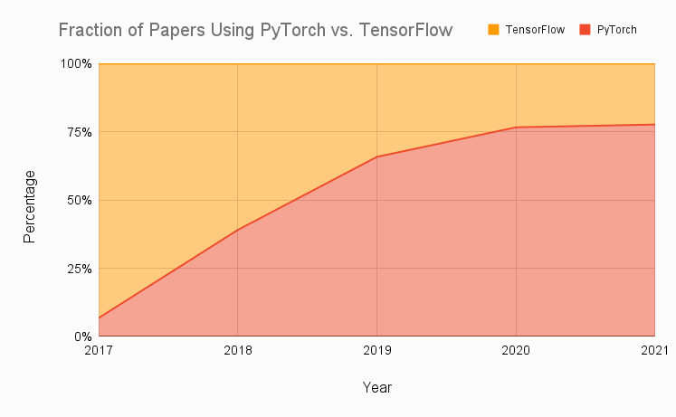
Technical pre-requisites
Framework of choice will be PyTorch! (not Tensorflow, not Keras, not MXNet, etc.)
Increasing popularity and preferred to Google’s Tensorflow these days for many reasons.
Learn more, if curious: https://www.assemblyai.com/blog/pytorch-vs-tensorflow-in-2022/

Slide 19
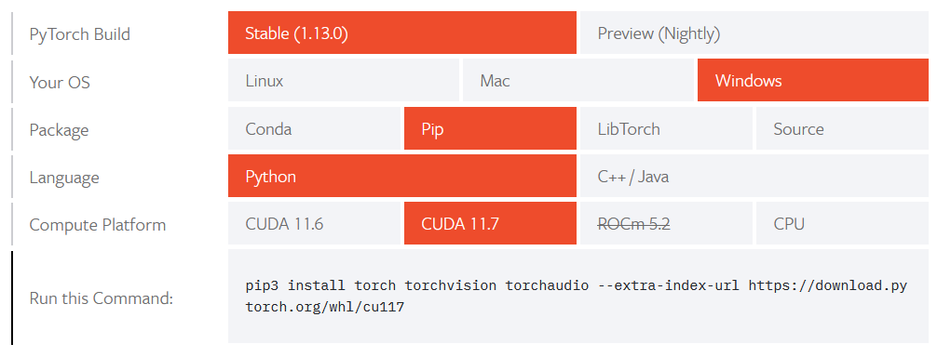
Installing PyTorch and CUDA
Install PyTorch, by getting the right version from https://pytorch.org/get-started/locally/

Slide 20
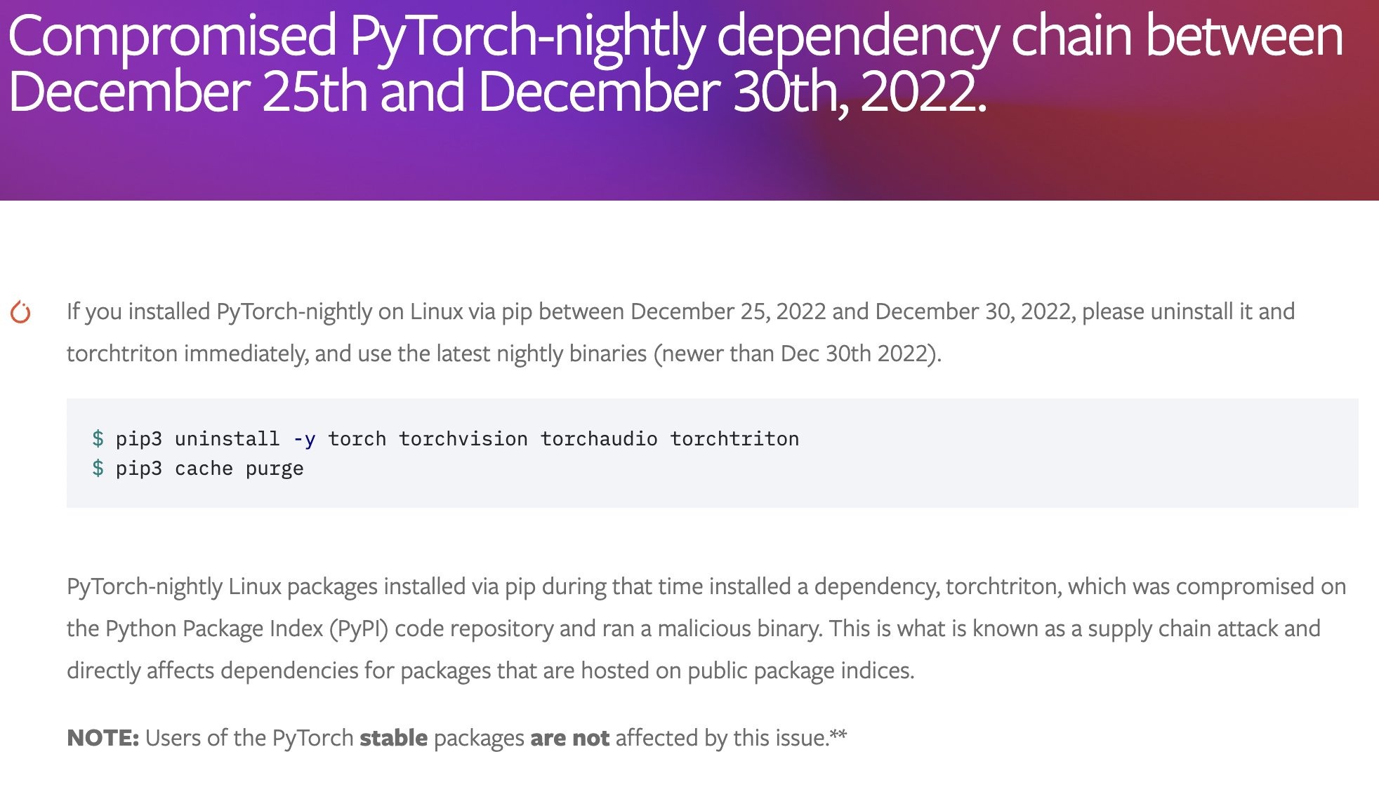
Installing PyTorch and CUDA

Slide 21
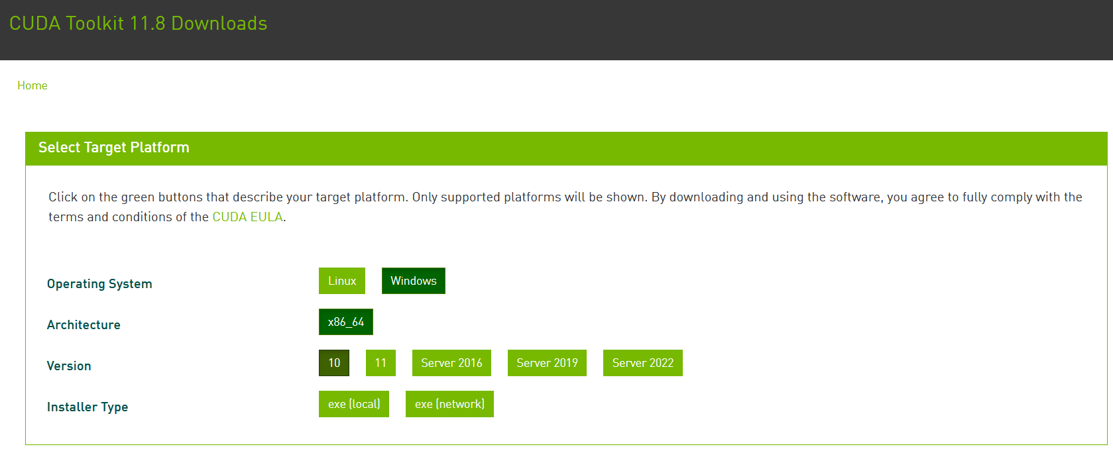
Installing PyTorch and CUDA
Check if your GPU is in the list of acceptable GPUs. https://developer.nvidia.com/cuda-gpus
If so, install CUDA (check version number matches PyTorch install!) https://developer.nvidia.com/cuda-downloads

Slide 22
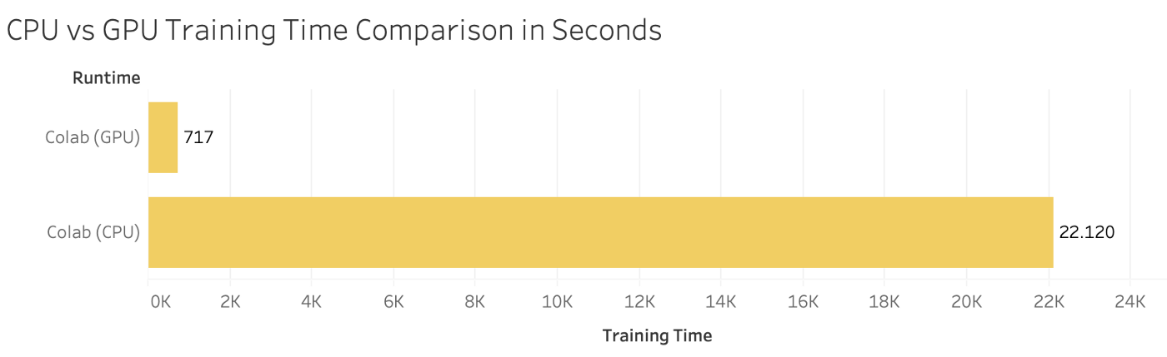

Installing PyTorch and CUDA
GPU not in the list of CUDA-enabled GPUs? Most notebooks can still run on CPU (but they might take significantly longer).
Always the option of using Google Colab, or create an education account on AWS.

Slide 23
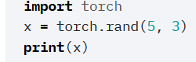
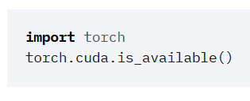
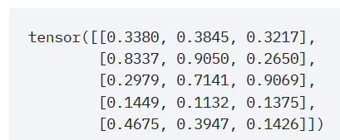
Checking your PyTorch and CUDA install
Hello World for PyTorch: to check you have PyTorch installed correctly. The code below should run and display a tensor.
Hello World for CUDA: to check you have correctly installed CUDA on top of PyTorch. The code below should print True, as the output of torch.cuda.is_available()

Slide 24

A quick word about PyTorch 2.0
PyTorch 2.0 has been announced end of 2022 and will have several new features, including
torch.compile(), which allows for faster training,
and the ability to move parts of the PyTorch framework from C++ back into Python.
It will also be cloud-agnostic, open-source.

Slide 25
A quick word about PyTorch 2.0
PyTorch 2.0 is currently still in its experimental phase. Stable PyTorch 2.0 release date is slotted for March 2023.
(Some nightlies releases are available, but I would advise against using them for now!
Allow me to explore it a bit more first and let us discuss it again in Week 13!)

Slide 26
About this week (Week 1)
What are the typical concepts of Machine Learning to be used as a starting point for this course?
What are the different families of problems in Deep Learning?
What is the typical structure of a Deep Learning problem?
What is linear regression and how to implement it?
What is the gradient descent algorithm and how is it used to train Machine Learning models?
What is polynomial regression and how to implement it?
What is regularization and how to implement it in Ridge regression?

Slide 27
About this week (Week 1)
What is overfitting and why is it bad?
What is underfitting and why is it bad?
What is generalization and how to evaluate it?
What is a train-test split and why is it related to generalization?
What is a sigmoid function? What is a logistic function?
How to perform binary classification using a logistic regressor and how is it related to linear regression?

Slide 28
About this week (Week 1)
What are Neural Networks and how do they relate to the biology of a human brain?
What is a Neuron in a Neural Network and how does it relate to linear/logistic regression?
What is the difference between a shallow and a deep neural network?
How to implement a shallow Neural Network manually and define a forward propagation method for it?
How to train a shallow Neural Network using backpropagation? How to define backward propagation and trainer functions?

Slide 29
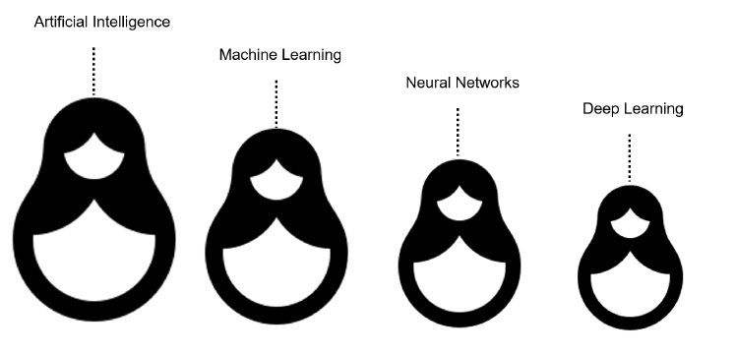
What is AI/ML/NN/DL?
Artificial intelligence
Machine Learning
Neural Networks
Deep Learning
Definition (Artificial Intelligence):
“In Computer Science, Artificial Intelligence (AI) refers to the theory and development of computer systems capable to perform cognitive tasks that normally require human intelligence, such as visual perception, speech recognition, decision-making, and translation between languages.”

Slide 30
What is AI/ML/NN/DL?
Conventional programming
Definition (Machine Learning):
In Computer Science, Machine Learning (ML) refers to the field of study that describes techniques and algorithms that give computers the ability to learn without being explicitly programmed.
Some implementations of machine learning may rely on data and neural networks.
- Arthur Samuel (1959).
Input (Given)
Function
(Created)
Output
(Obtained)
VS.
Machine Learning
Input (Available)
Function
(?)
Output
(Available)

Slide 31
What is AI/ML/NN/DL?
What we have done in programming so far was to design functions,
which would do specific operations,
and return outputs,
for any input we could give it.
But sometimes, we can encounter problems where
we can easily find inputs and expected outputs,
but the function to be coded is not simple to figure out.
E.g., what animal is in the picture?
Input (Given)
Function
(Created)
Output
(Obtained)
Input (Available)
Function
(?)
Output
(Available)

Slide 32

What is AI/ML/NN/DL?
E.g., what animal is in the picture?
Typical problem in Computer Vision, called Image Recognition.
Input x (available)
Function f
(?)
Output y = f(x)
(available)
It’s a cat!

Slide 33
What is AI/ML/NN/DL?
E.g., what animal is in the picture?
Typical problem in Computer Vision, called Image Recognition.
Input x (available)
Function f
(?)
Output y = f(x)
(available)
Very easy for a human…
But, how would we do it with a computer?
It’s a cat!

Slide 34
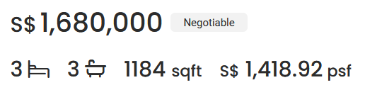
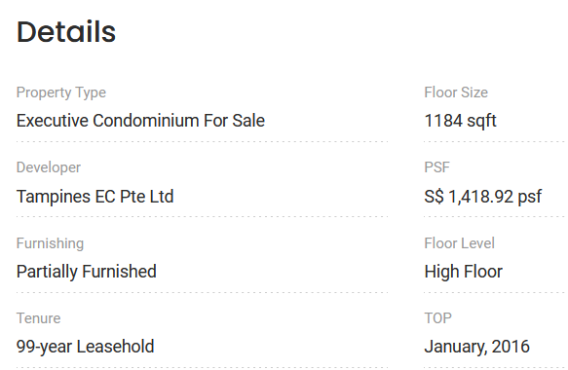

What is AI/ML/NN/DL?
Other scenarios of difficult functions have to do with tasks where there is no easy closed-form expression connecting inputs to outputs.
E.g., what is a good selling price for my appartment?
Guessing the selling price of an appartment based on its parameters (size, location, etc.) and previous sales.

Slide 35

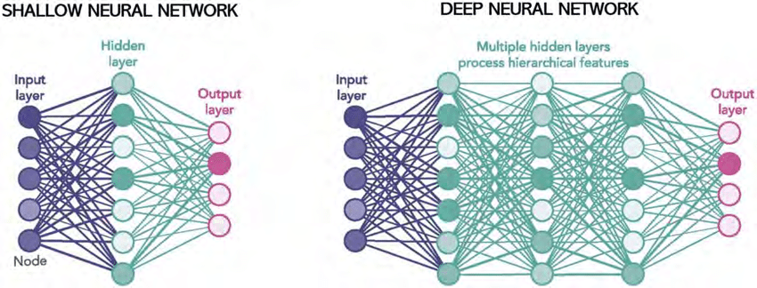
What is AI/ML/NN/DL?
Definition (Neural Networks):
Neural Networks (NNs) are computing systems inspired by the biological neural networks that constitute animal brains.
NNs are based on a collection of connected units or nodes called artificial neurons, which loosely model the neurons in a biological brain.

Slide 36
What is AI/ML/NN/DL?
Definition (Neural Networks):
Neural Networks (NNs) are computing systems inspired by the biological neural networks that constitute animal brains.
NNs are based on a collection of connected units or nodes called artificial neurons, which loosely model the neurons in a biological brain.
Each connection, like the synapses in a biological brain, can transmit a signal to other neurons, therefore processing any information given as inputs to produce a final signal as output.

Slide 37
What is AI/ML/NN/DL?
Definition (Deep Learning):
Deep Learning (DL) is a subfield of machine learning, and deep neural networks make up the backbone of deep learning algorithms.
The number of node layers, or depth, of neural networks is what distinguishes a shallow neural network from a deep neural network, which must have more than three.

Slide 38
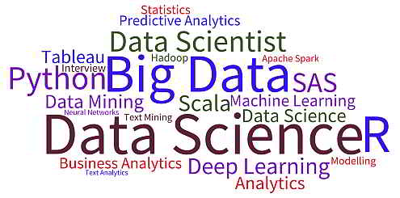
What is AI/ML/NN/DL?
Artificial intelligence
Machine Learning
Neural Networks
Deep Learning

Slide 39
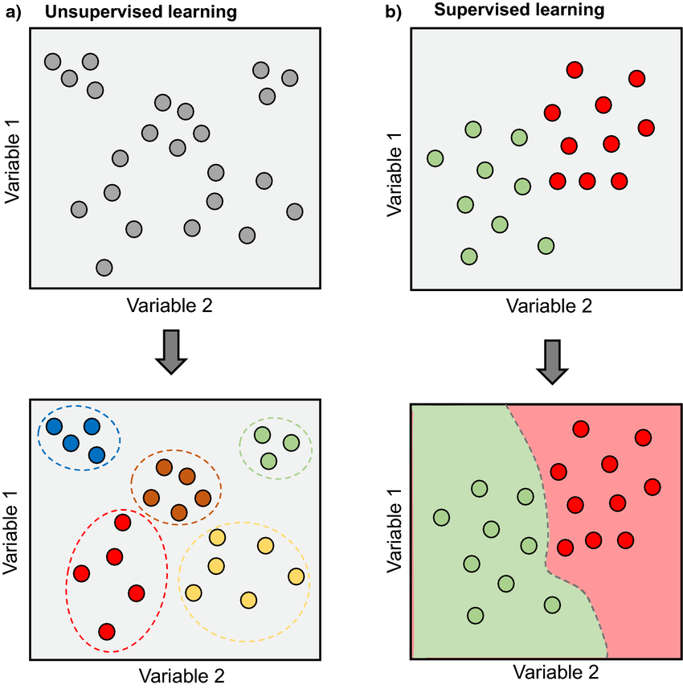
Supervised vs Unsupervised Learning
Definition (Supervised vs. Unsupervised Learning):
Supervised and Unsupervised Learning are the two techniques of machine learning.
The main difference is the need for labelled training data:
Supervised machine learning relies on labelled input and output data to learn and make predictions,
while unsupervised learning does not require labelled data.

Slide 40

Supervised Learning Examples
Examples of supervised learning: spam detection, text classification, predicting the stock market, etc.

Slide 41
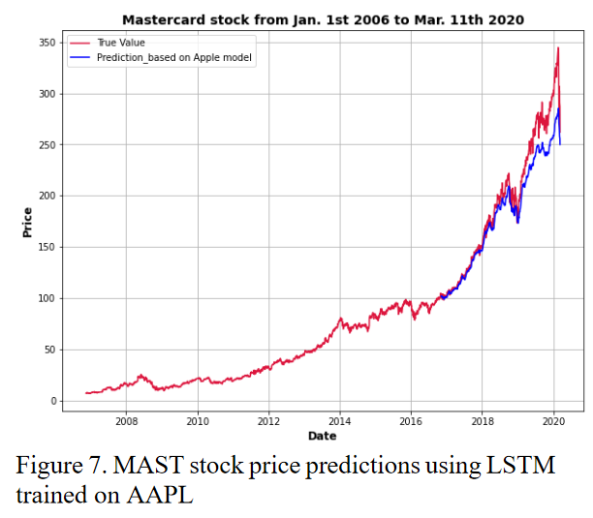
Supervised Learning Examples
Examples of supervised learning: spam detection, text classification, predicting the stock market, etc.

Slide 42
Regression vs. Classification
Definition (Regression):
Regression models are used to identify the relationships between the input and output variables.
Regression algorithms are used to predict continuous values such as price, salary, age, etc.
In regression, the outputs are often continuous numerical values.

Slide 43
Regression vs. Classification (Supervised)
Definition (Classification):
Classification models are used to divide the samples in the dataset into different classes.
Classification algorithms are then used to predict/classify discrete values, such as Male or Female, True or False, Spam or Not Spam, etc.
In Classification, the outputs are discrete or categorical values.

Slide 44
Supervised Learning Examples
Example: predicting the market.
Question: is it a regression or a classification task?

Slide 45
Supervised Learning Examples
Example: predicting the market.
Question: is it a regression or a classification task?
Depends.
If the output we are predicting is the value of the stock in the future, then probably regression.

Slide 46
Supervised Learning Examples
Example: predicting the market.
Question: is it a regression or a classification task?
Depends.
If the output we are predicting is the value of the stock in the future, then probably regression.
If the plan is to predict whether we should buy, sell or wait, then probably classification.

Slide 47
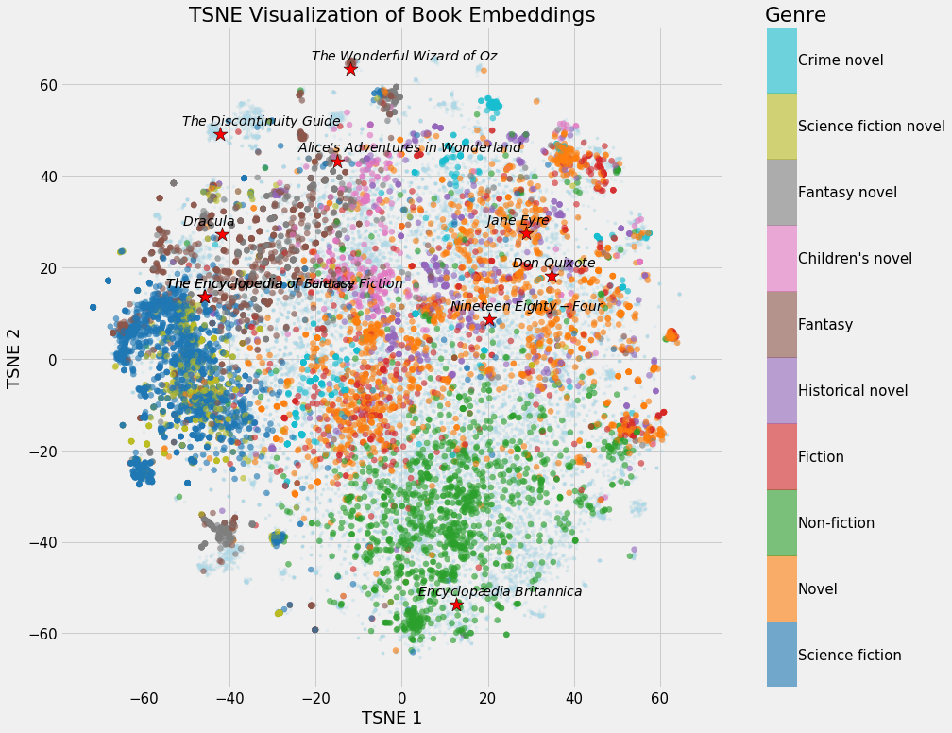
Unsupervised Learning Examples
Examples of unsupervised learning: clustering customers based on their behaviors, segmenting images, and identifying topics in a document.

Slide 48
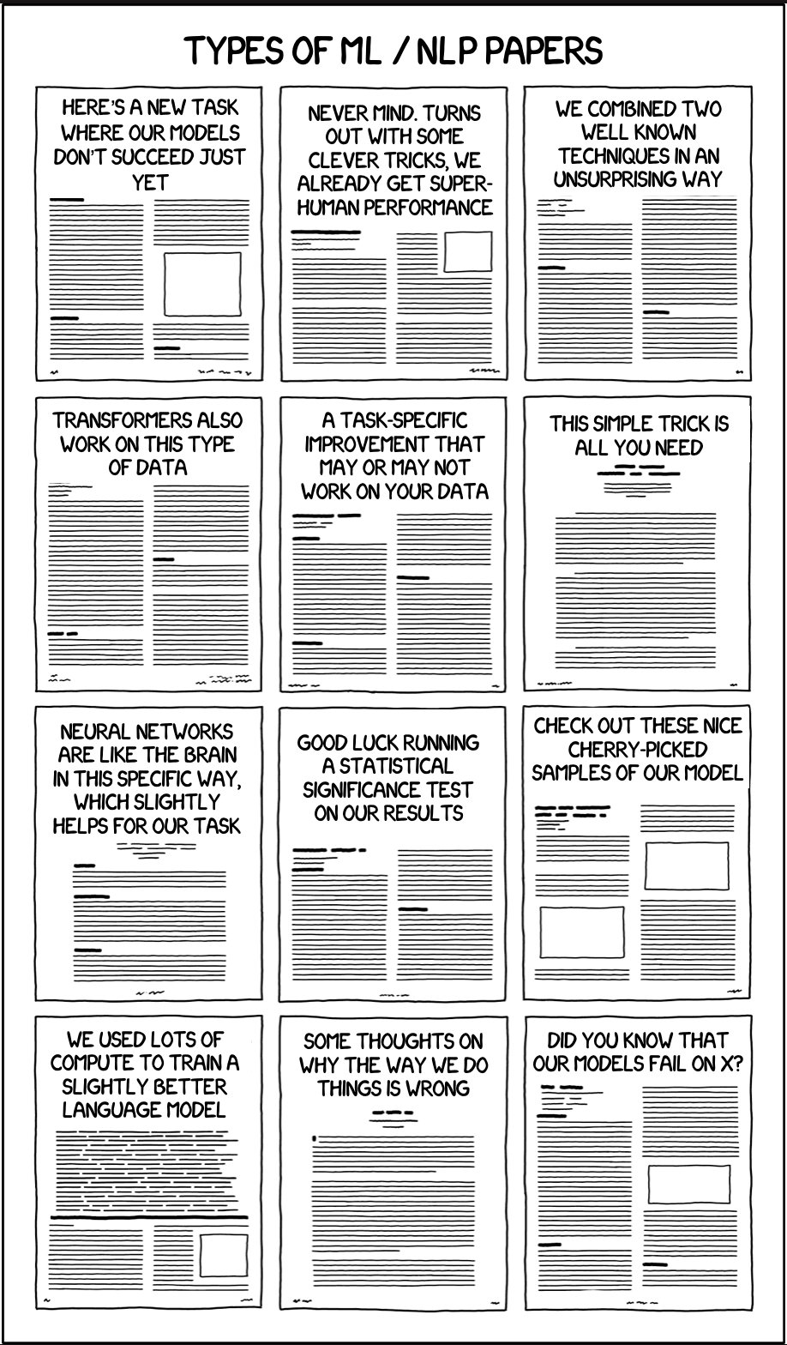
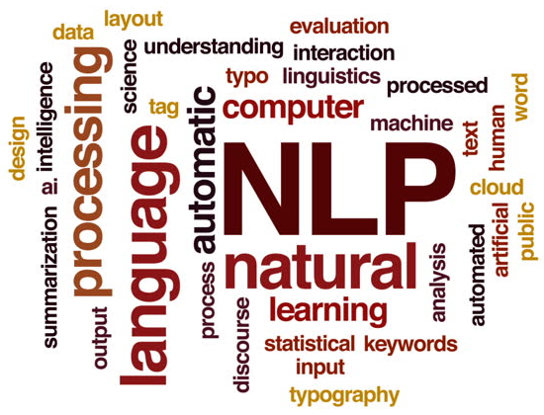
Unsupervised Learning Examples
Identify topics that seem to appear in those papers and their prominence
Examples of unsupervised learning: clustering customers based on their behaviors, segmenting images, and identifying topics in a document.

Slide 49
Clustering vs. Association (Unsupervised)
Definition (Clustering vs. Association):
Unsupervised learning can be used for two types of problems: Clustering and Association.
The main difference is that
clustering groups data based on similarity,
while association looks for relationships between variables.

Slide 50
Clustering vs. Association (Unsupervised)
Examples of clustering:
Group customers into clusters based on the similarities in their purchasing behaviours, such as their spending habits or types of products they like.
Group the catalogue of movies available on Netflix and identify what movies have in common, so you can later recommend a movie to a user based on what he/she has seen before.

Slide 51
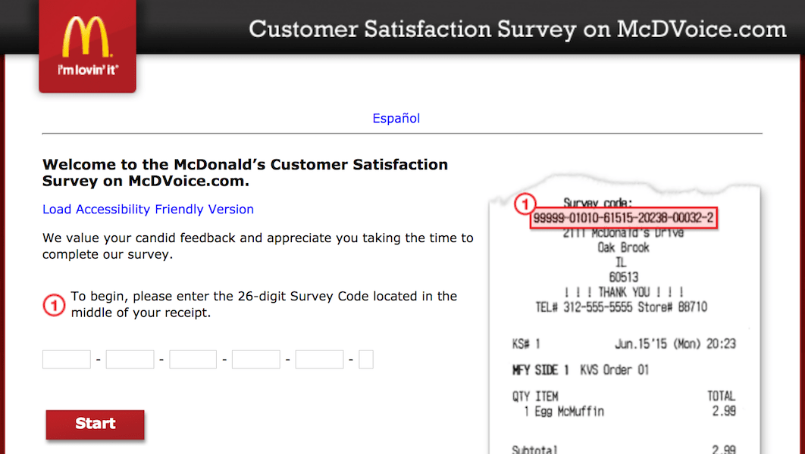

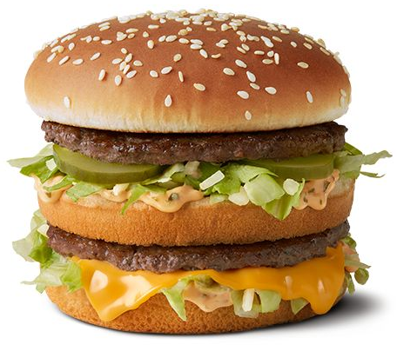

Clustering vs. Association (Unsupervised)
Example of association:
Finding the relationship between customer buying behaviors and customer satisfaction.
Association can be used to understand how changes in customer behavior impacts customer satisfaction, such as if buying a certain product increases customer satisfaction (or the opposite).

Slide 52
Deep Learning and Supervised/Unsupervised
While it is possible to use Deep Learning models and Neural Networks to perform both Supervised and Unsupervised tasks…
The vast majority of DL/NN tasks fall in the category of supervised learning.
(And we will therefore mostly focus on that)

Slide 53
Elements of a ML problem
Definition (Elements of a Machine Learning problem):
Machine learning problems should be well-defined, i.e. the following elements must be clearly identified:
Task (T) at hand,
Inputs (I) and Outputs (O),
Model (M) definition and its trainable parameters (P),
Loss (L) function to measure the performance on said task and dataset.

Slide 54
Elements of a ML problem
In the example on the right…
Task (T) at hand:
Predict price of an apartment based on the apartment features.
Using a dataset consisting of previously seen appartments to learn the selling prices of apartments.
It is therefore a supervised regression task.

Slide 55
Elements of a ML problem
In the example on the right…
Inputs (I) and Outputs (O):
Inputs will be a list of apartment features (e.g. number of bathrooms, number of bedrooms, surface size, etc.).
Output will be the selling price in SGD or surface price in SGD per sqft.

Slide 56
Elements of a ML problem
In the example on the right…
Model (M) definition and its trainable parameters (P):
Could be a linear or polynomial regression model (to be discussed this week). Or a neural network of some sort. Or even something else (check your ML course!)
Loss (L) function to measure the performance on said task and dataset:
To be discussed later, as this might depend on the model used.

Slide 57
Our first toy example
Our first toy example: simplified version of the apartment price prediction.
Task (T) at hand:
Predict price of an apartment based on the apartment features.
We will generate a “fake” dataset consisting of appartments with features and selling prices.
Supervised regression task.

Slide 58
Our first toy example
Our first toy example: simplified version of the apartment price prediction.
Inputs (I) and Outputs (O):
Inputs will be a list of apartment features, which here will only consist of the surface of the apartment, in square meters (sqm).
Output will be the selling price in millions of SGD (mSGD).

Slide 59
Our first toy example (mock dataset)
Have a look at Week 1, Notebook 1.
We will create a dataset, which uses surfaces as inputs, with values drawn randomly between 40 and 150 sqm.
We will assume that the price is randomly generated, using a uniform distribution, with
average 100000 + 14373 times the surface in sqm,
and a "variance" of +/- 10% around the average value.

Slide 60
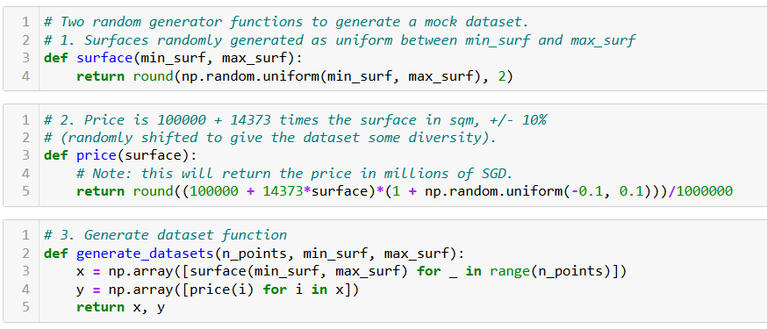
Our first toy example (mock dataset)

Slide 61
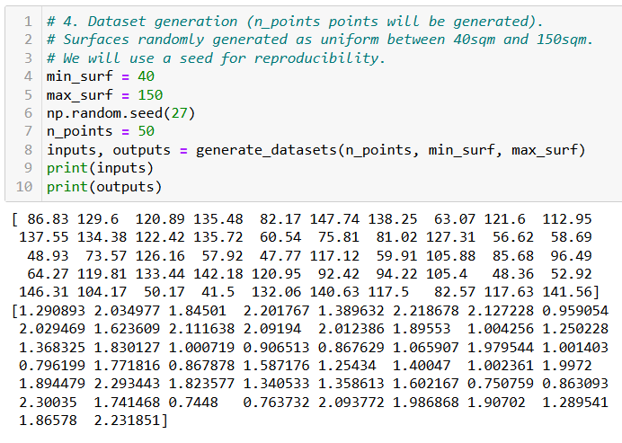
Our first toy example (mock dataset)

Slide 62
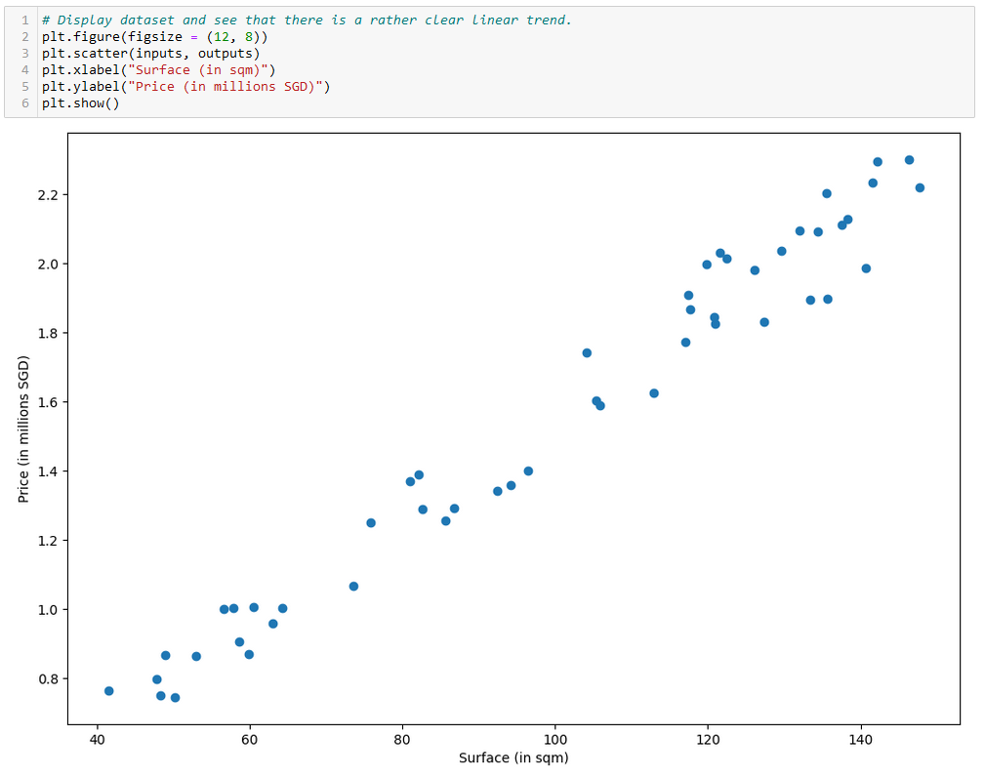

Slide 63
Our first toy example
Our first toy example: simplified version of the apartment price prediction.
Model (M) definition and its trainable parameters (P):
Here, our model will consist of a linear regression model.

Slide 64
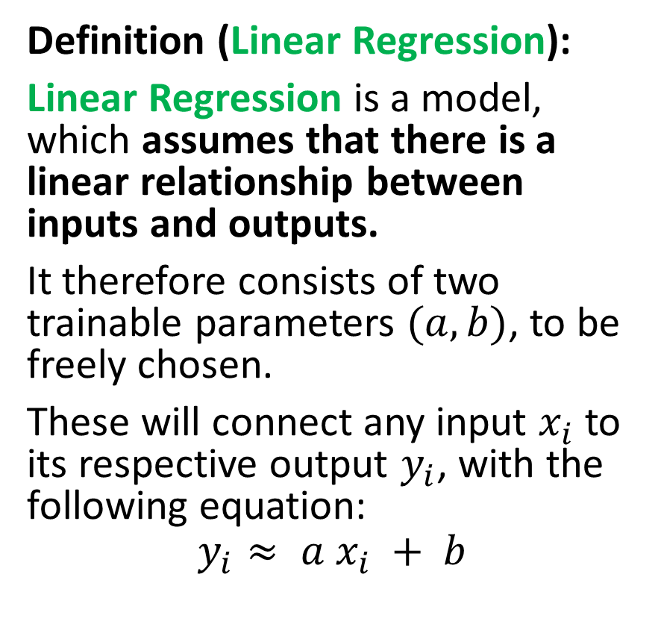
Our first model, the linear regression
Definition (Linear Regression):
Linear Regression is a model, which assumes that there is a linear relationship between inputs and outputs.
It therefore consists of two trainable parameters $(a, b)$, to be freely chosen.
These will connect any input $x_{i}$ to its respective output $y_{i}$, with the following equation:
$$y_{i}≈ a x_{i} + b$$

Slide 65
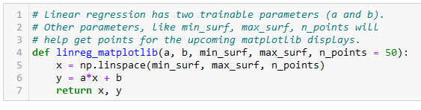
Our first model, the linear regression
Definition (Linear Regression):
Linear Regression is a model, which assumes that there is a linear relationship between inputs and outputs.
It therefore consists of two trainable parameters $(a, b)$, to be freely chosen.
These will connect any input $x_{i}$ to its respective output $y_{i}$, with the following equation:
$$y_{i}≈ a x_{i} + b$$

Slide 66
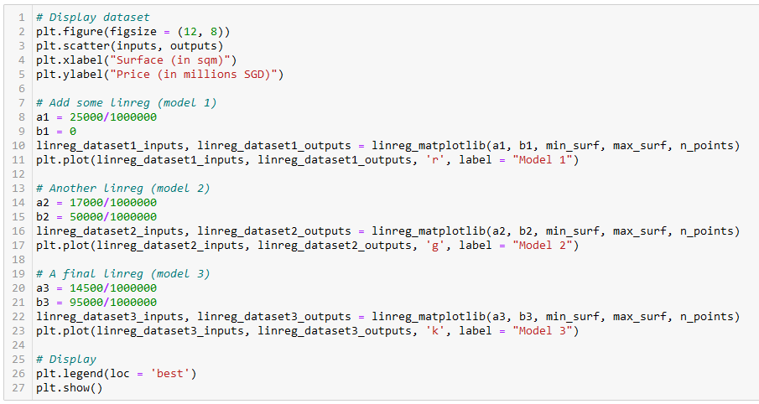
Let us try different values of (a, b)
Model 1
Model 2
Model 3

Slide 67
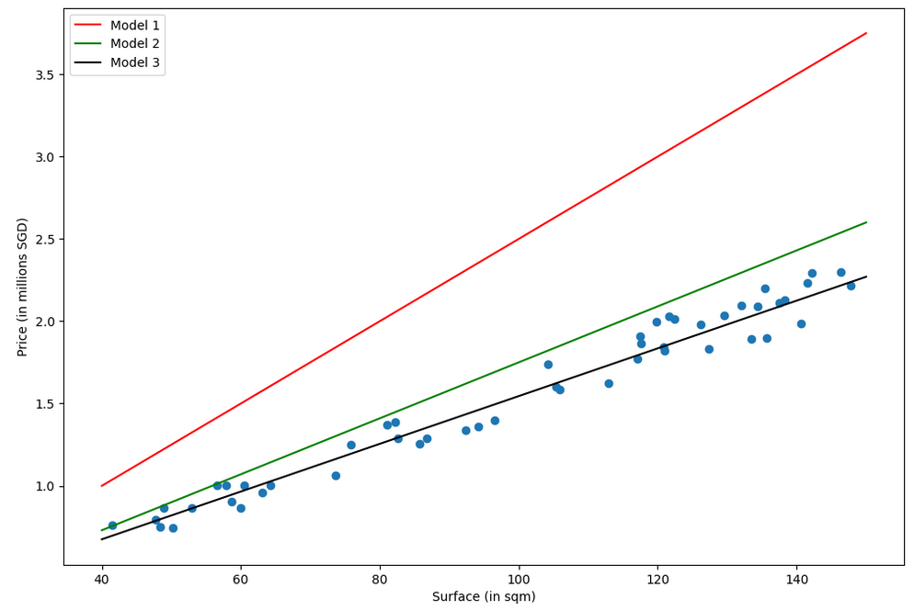
Which model is best in your opinion? (red, green or black)
Why is one better than another?

Slide 68
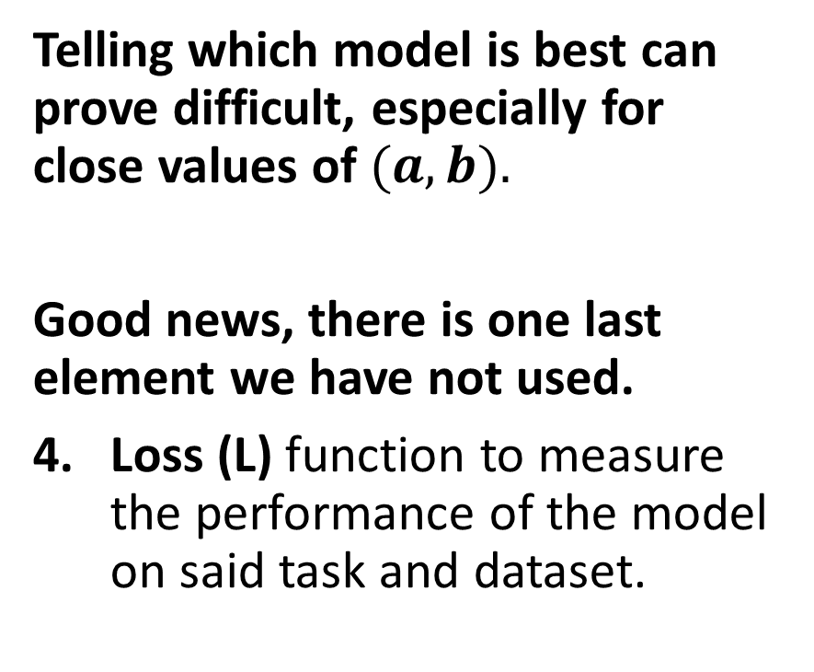
The need for a loss function
Which model is best in your opinion? (red, green or black)
Why is one better than another?
Telling which model is best can prove difficult, especially for close values of $(a, b).$
Good news, there is one last element we have not used.
Loss (L) function to measure the performance of the model on said task and dataset.

Slide 69
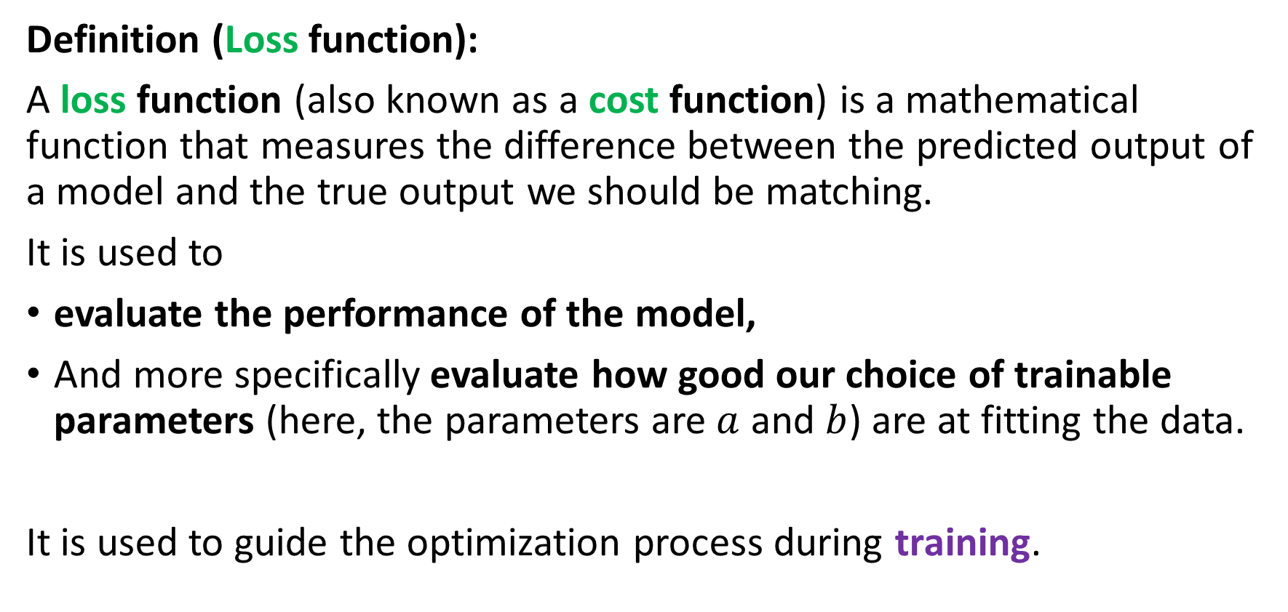
The need for a loss function
Definition (Loss function):
A loss function (also known as a cost function) is a mathematical function that measures the difference between the predicted output of a model and the true output we should be matching.
It is used to
evaluate the performance of the model,
And more specifically evaluate how good our choice of trainable parameters (here, the parameters are $a$ and $b$) are at fitting the data.
It is used to guide the optimization process during training.

Slide 70
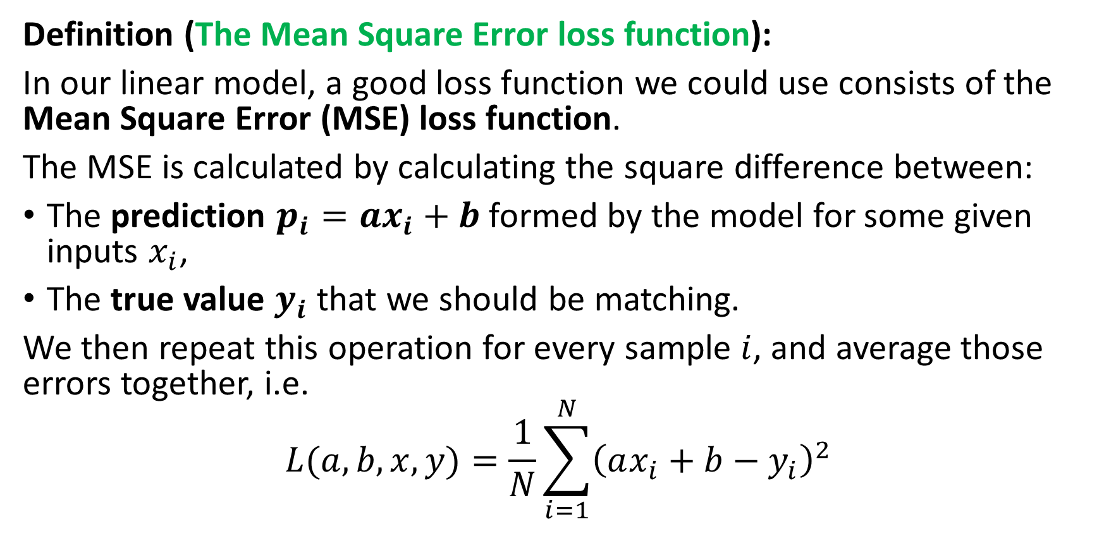
The need for a loss function
Definition (The Mean Square Error loss function):
In our linear model, a good loss function we could use consists of the Mean Square Error (MSE) loss function.
The MSE is calculated by calculating the square difference between:
The prediction $p_{i}=ax_{i}+b$formed by the model for some given inputs $x_{i}$,
The true value $y_{i}$ that we should be matching.
We then repeat this operation for every sample $i$, and average those errors together, i.e.
$$L(a, b,x, y)=\frac{1}{N}\sum_{i=1}^{N}{{\left(ax_{i}+b−y_{i}\right)}^{2}}$$

Slide 71
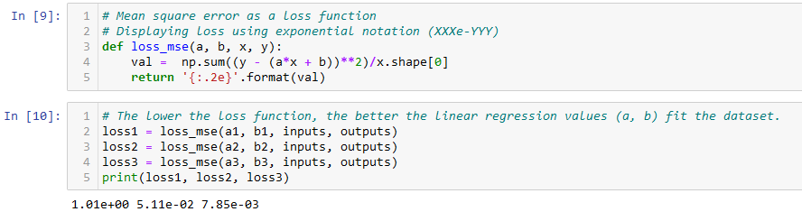
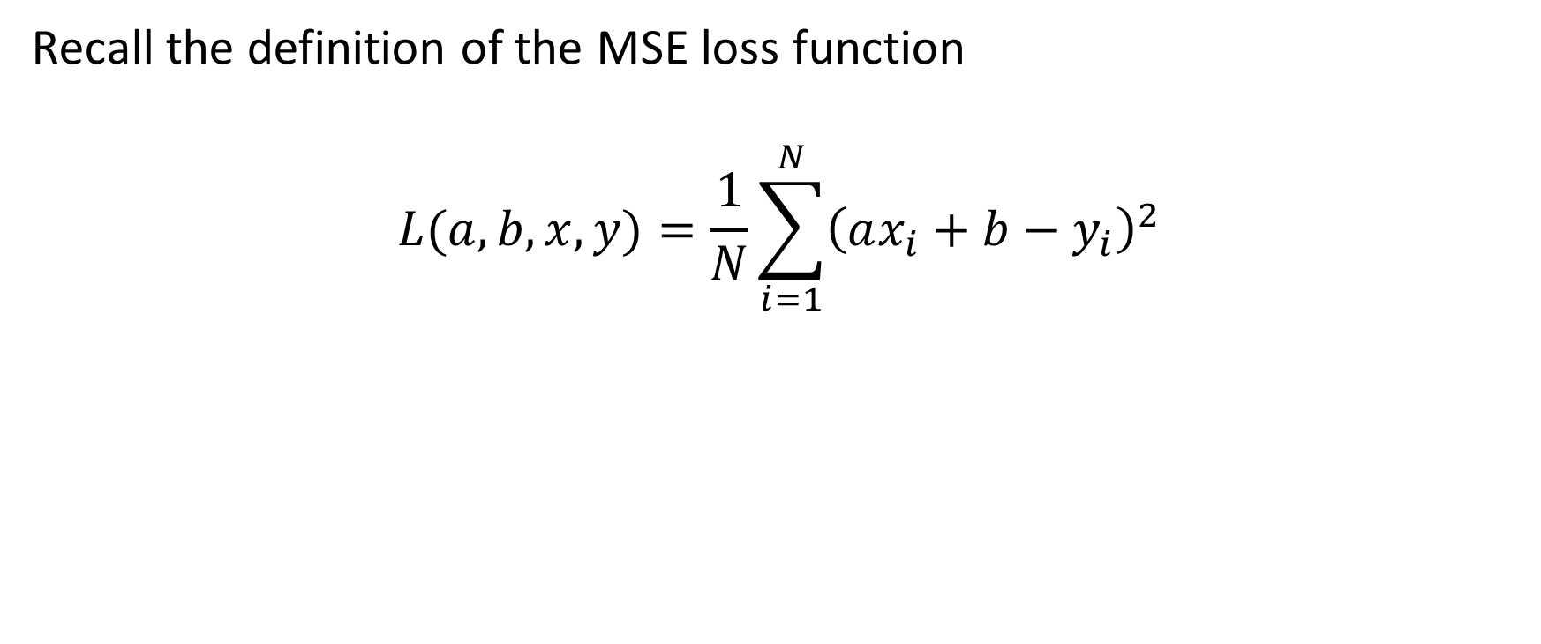
The need for a loss function
Recall the definition of the MSE loss function
$$L(a, b,x, y)=\frac{1}{N}\sum_{i=1}^{N}{{\left(ax_{i}+b−y_{i}\right)}^{2}}$$

Slide 72
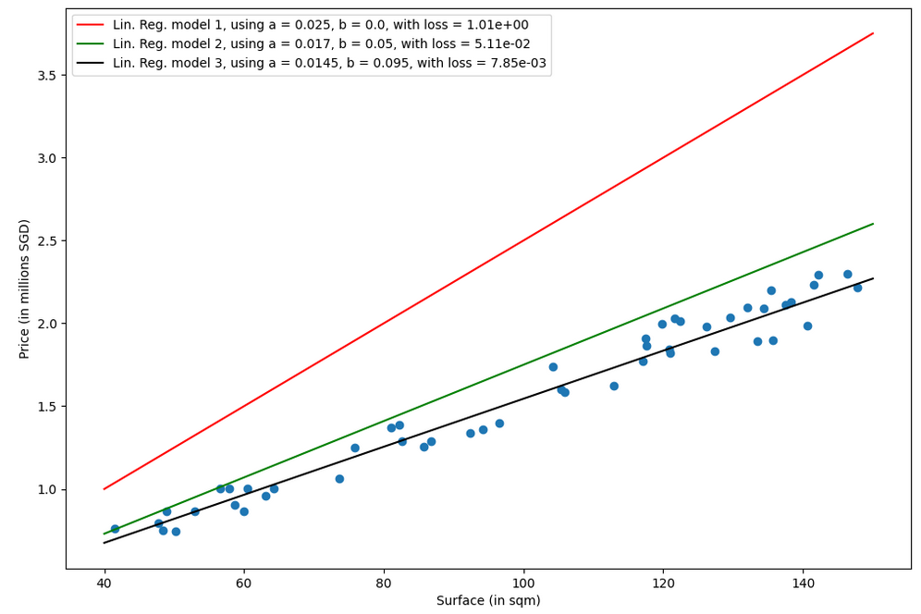

Slide 73
Training a model
Definition (Training a model):
Training a model consists of finding the best values for the trainable parameters of the chosen model, for the given task and dataset.
The goal of training is to find the set of model parameters that minimize the loss function. Once a minimal value is obtained on the loss function, then we can claim that the “optimal” trainable parameters have been found (or in other word, the model has been trained).

Slide 74
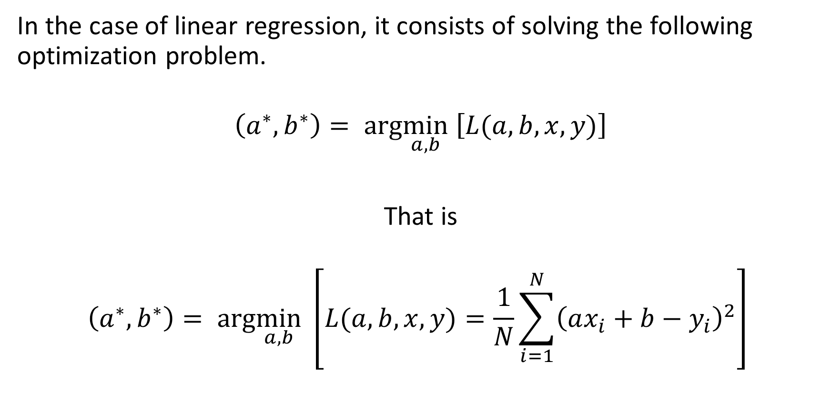
Training a linear regression model
In the case of linear regression, it consists of solving the following optimization problem.
$$\left(a^{∗},b^{∗}\right)= arg\min_{a,b} \left[L(a, b,x, y)\right]$$
That is
$$\left(a^{∗},b^{∗}\right)= arg\min_{a,b} \left[L(a, b,x, y)=\frac{1}{N}\sum_{i=1}^{N}{{\left(ax_{i}+b−y_{i}\right)}^{2}}\right]$$

Slide 75
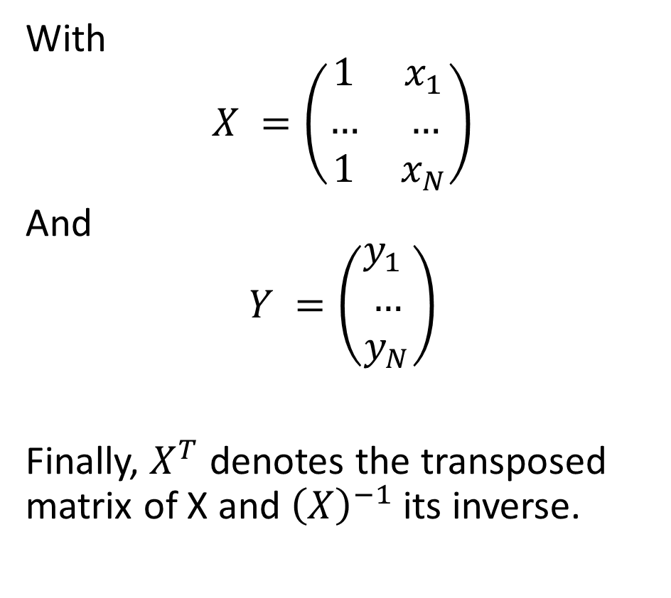
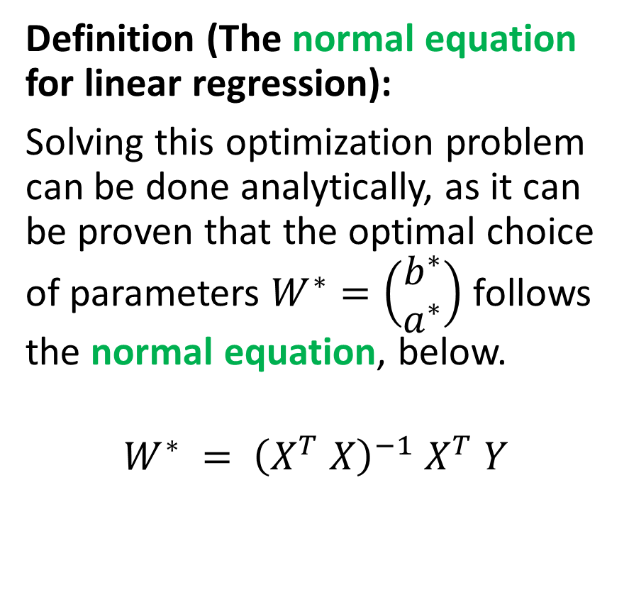
Training a linear regression model
Definition (The normal equation for linear regression):
Solving this optimization problem can be done analytically, as it can be proven that the optimal choice of parameters $W^{∗}=\left(\begin{matrix}b^{∗} \\ a^{∗}\end{matrix}\right)$ follows the normal equation, below.
$$W^{∗} = {\left(X^{T} X\right)}^{−1} X^{T} Y$$
With
$$X =\left(\begin{matrix}1 & x_{1} \\ … & … \\ 1 & x_{N}\end{matrix}\right)$$
And
$$Y =\left(\begin{matrix}y_{1} \\ … \\ y_{N}\end{matrix}\right)$$
Finally, $X^{T}$ denotes the transposed matrix of X and ${\left(X\right)}^{−1}$its inverse.

Slide 76
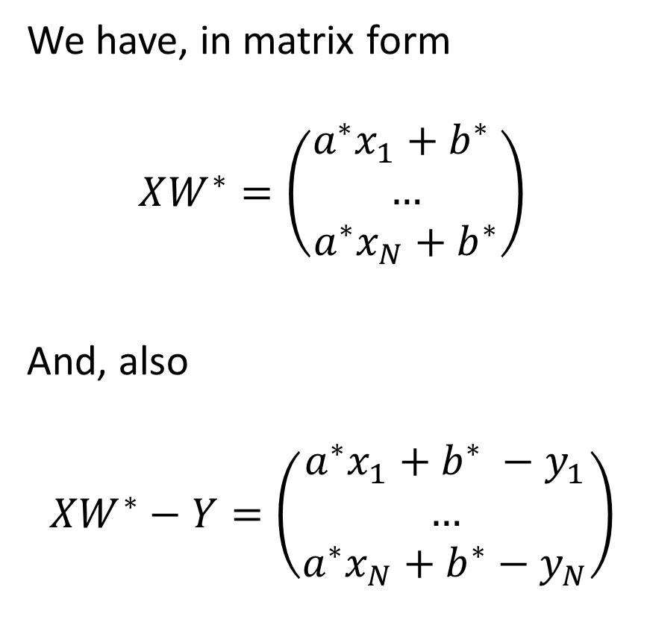
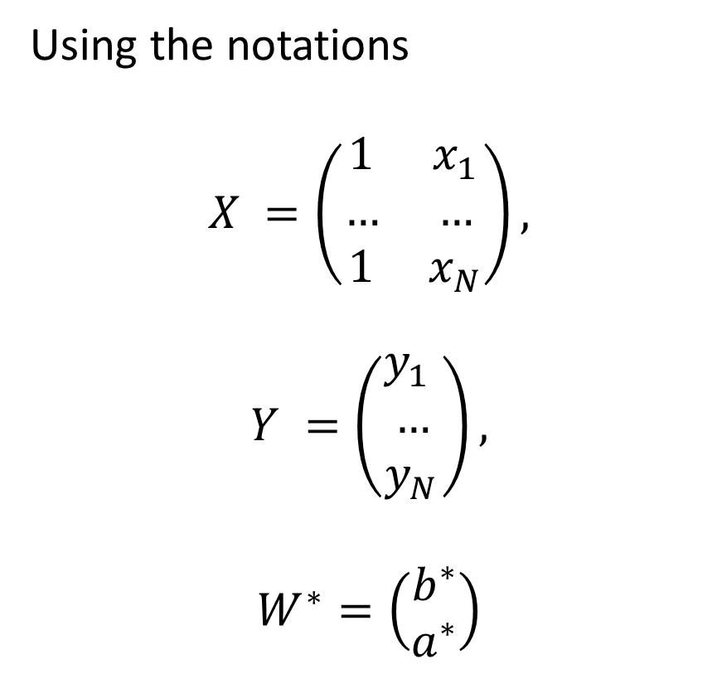
Proof of the Normal Equation
Using the notations
$$X =\left(\begin{matrix}1 & x_{1} \\ … & … \\ 1 & x_{N}\end{matrix}\right),$$
$$Y =\left(\begin{matrix}y_{1} \\ … \\ y_{N}\end{matrix}\right),$$
$$W^{∗}=\left(\begin{matrix}b^{∗} \\ a^{∗}\end{matrix}\right)$$
We have, in matrix form
$$XW^{∗}=\left(\begin{matrix}a^{∗}x_{1}+b^{∗} \\ … \\ a^{∗}x_{N}+b^{∗}\end{matrix}\right)$$
And, also
$$XW^{∗}−Y=\left(\begin{matrix}a^{∗}x_{1}+b^{∗} −y_{1} \\ … \\ a^{∗}x_{N}+b^{∗}−y_{N}\end{matrix}\right)$$

Slide 77
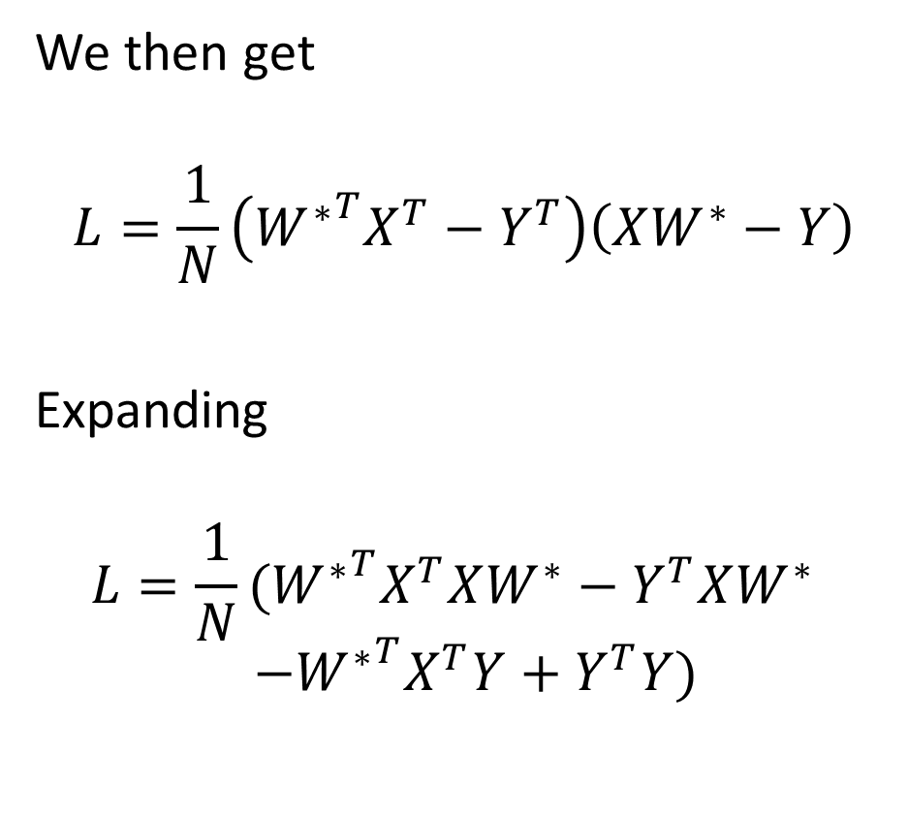
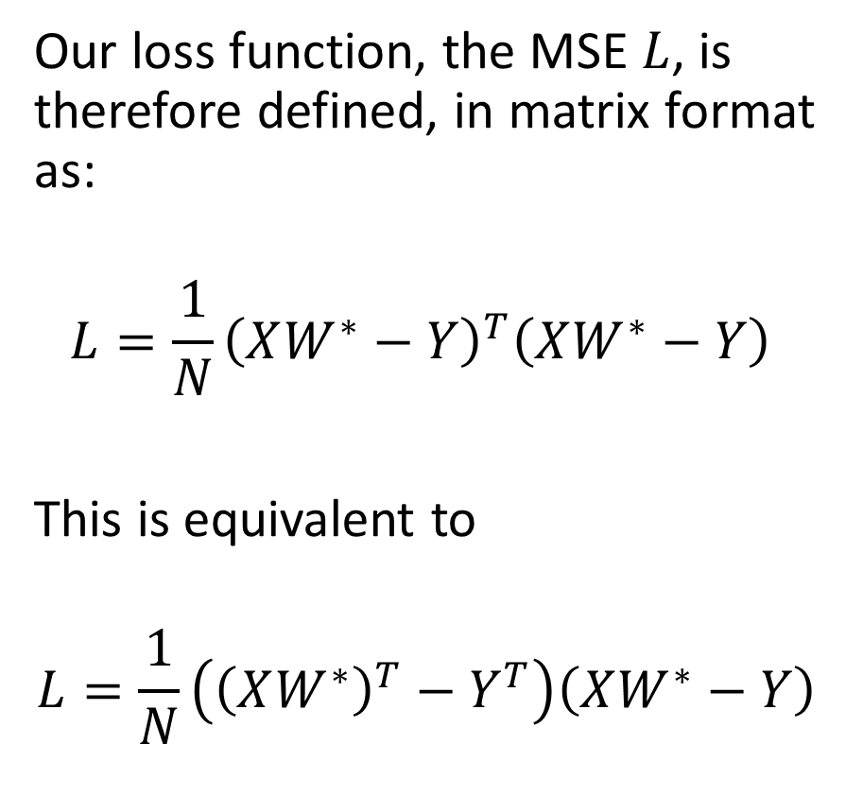
Proof of the Normal Equation
Our loss function, the MSE $L$, is therefore defined, in matrix format as:
$$L=\frac{1}{N}{\left(XW^{∗}−Y\right)}^{T}\left(XW^{∗}−Y\right)$$
This is equivalent to
$$L=\frac{1}{N}\left({\left(XW^{∗}\right)}^{T}−Y^{T}\right)\left(XW^{∗}−Y\right)$$
We then get
$$L=\frac{1}{N}\left({W^{∗}}^{T}X^{T}−Y^{T}\right)\left(XW^{∗}−Y\right)$$
Expanding
$$L=\frac{1}{N}({W^{∗}}^{T}X^{T}XW^{∗}−Y^{T}XW^{∗})$$
$$(−{W^{∗}}^{T}X^{T}Y+Y^{T}Y)$$

Slide 78
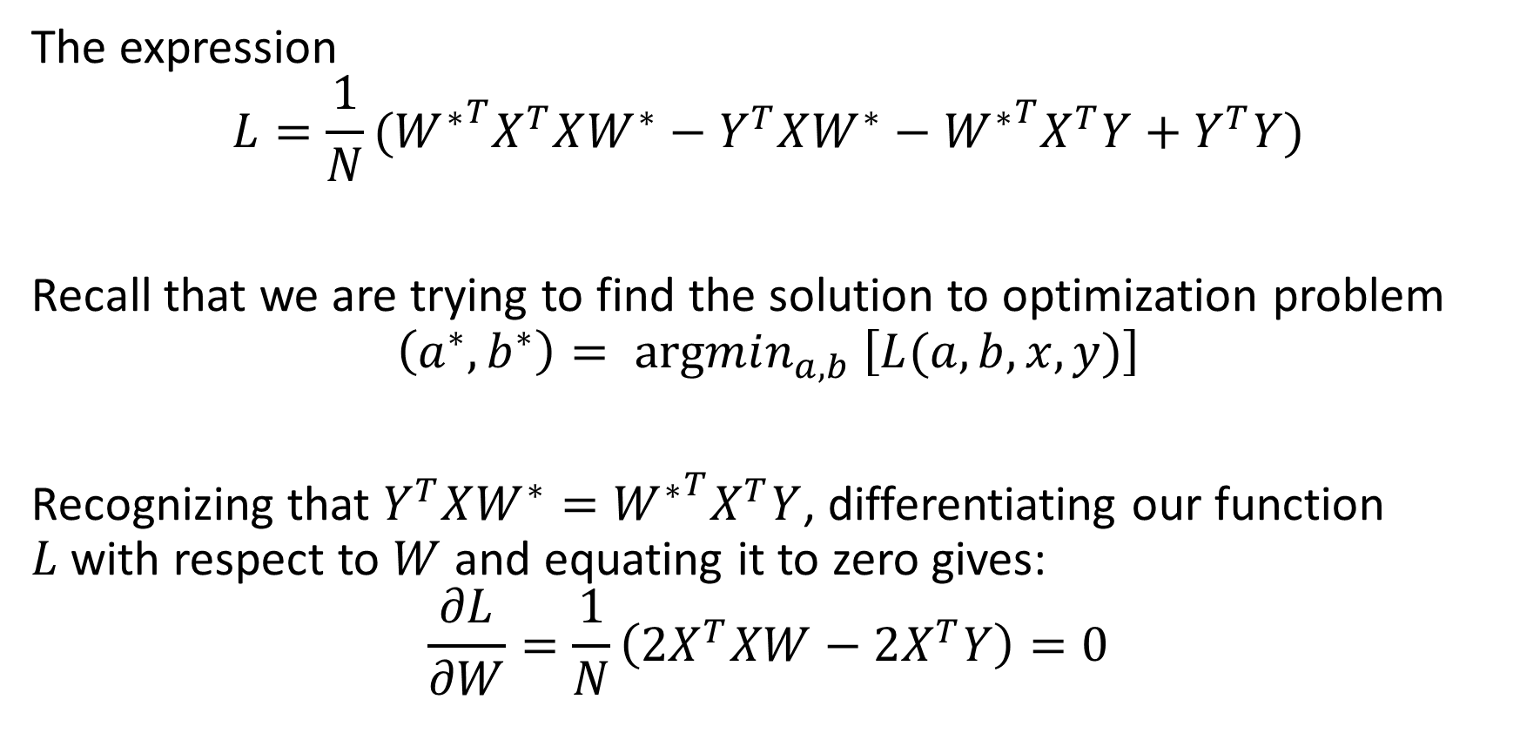
Proof of the Normal Equation
The expression
$$L=\frac{1}{N}({W^{∗}}^{T}X^{T}XW^{∗}−Y^{T}XW^{∗}−{W^{∗}}^{T}X^{T}Y+Y^{T}Y)$$
Recall that we are trying to find the solution to optimization problem
$$\left(a^{∗},b^{∗}\right)= argmin_{a,b} \left[L(a, b,x, y)\right]$$
Recognizing that $Y^{T}XW^{∗}={W^{∗}}^{T}X^{T}Y$, differentiating our function $L$with respect to $W$ and equating it to zero gives:
$$\frac{∂L}{∂W}=\frac{1}{N}\left({2X}^{T}XW−2X^{T}Y\right)=0$$

Slide 79
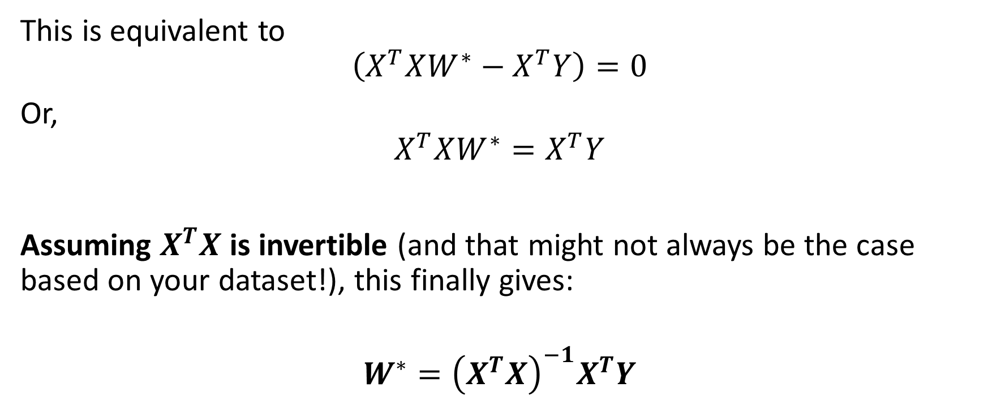
Proof of the Normal Equation
This is equivalent to
$$\left(X^{T}XW^{∗}−X^{T}Y\right)=0$$
Or,
$$X^{T}XW^{∗}=X^{T}Y$$
Assuming $X^{T}X$ is invertible (and that might not always be the case based on your dataset!), this finally gives:
$$W^{∗}={\left(X^{T}X\right)}^{−1}X^{T}Y$$

Slide 80
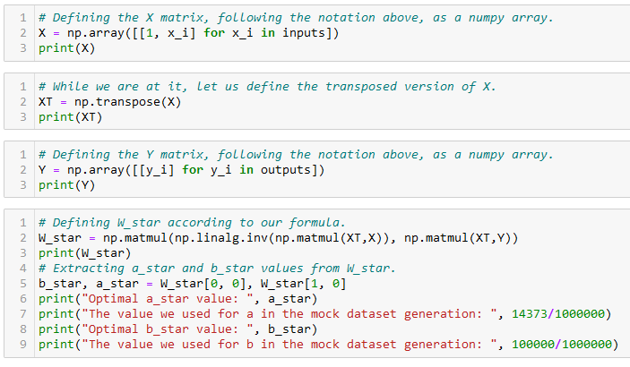
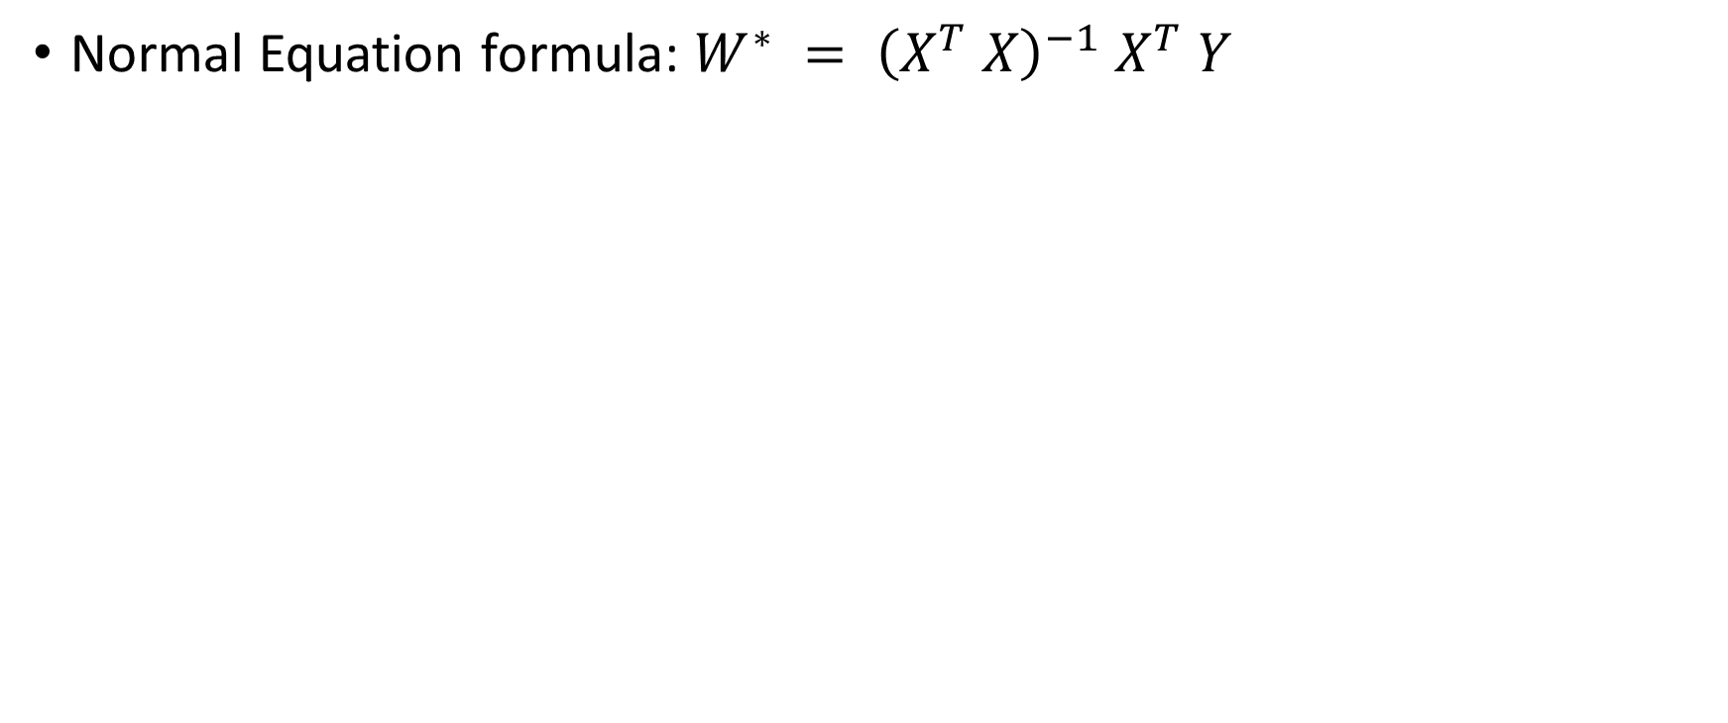
Training a linear regression model
Normal Equation formula: $W^{∗} = {\left(X^{T} X\right)}^{−1} X^{T} Y$

Slide 81
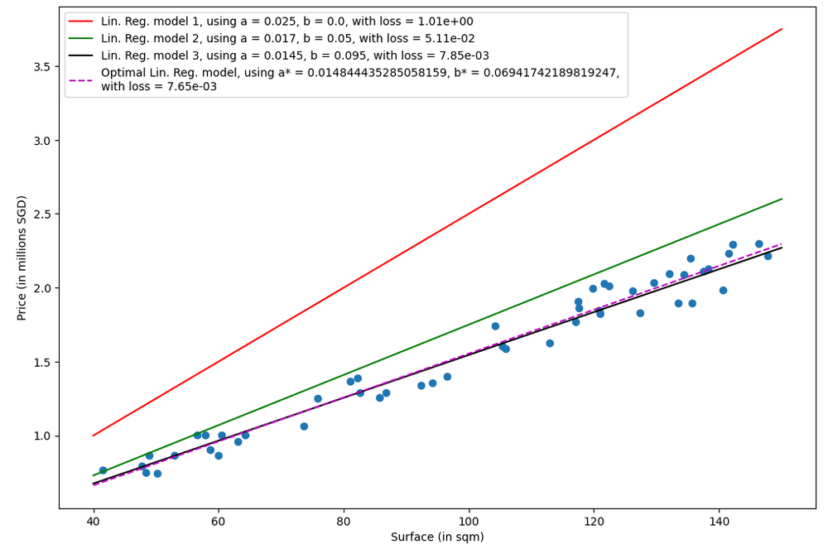

Slide 82
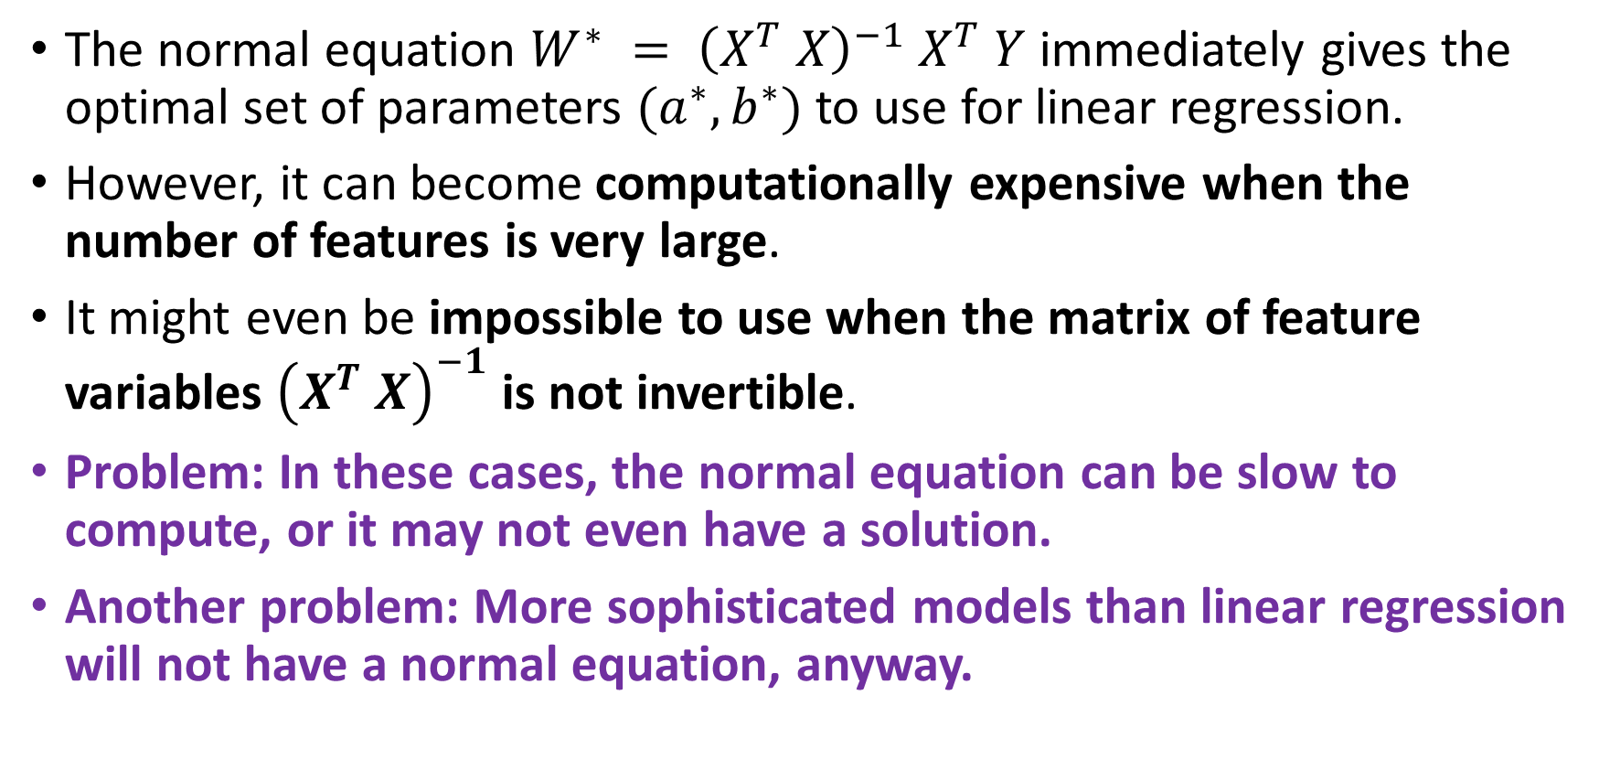
A problem with the normal equation
The normal equation $W^{∗} = {\left(X^{T} X\right)}^{−1} X^{T} Y$immediately gives the optimal set of parameters $(a^{∗}, b^{∗})$to use for linear regression.
However, it can become computationally expensive when the number of features is very large.
It might even be impossible to use when the matrix of feature variables ${\left(X^{T} X\right)}^{−1}$ is not invertible.
Problem: In these cases, the normal equation can be slow to compute, or it may not even have a solution.
Another problem: More sophisticated models than linear regression will not have a normal equation, anyway.

Slide 83
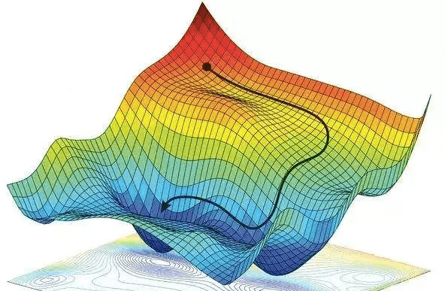
Gradient Descent, to the rescue!
Definition (Gradient Descent):
Gradient Descent (GD) is an iterative algorithm used to solve optimization problems.
It starts with an initial set of parameters.
It then repeatedly updates the parameters in the direction of the negative gradient of the given cost function, until it converges to a local minimum.
Forgot about GD? Have a look at your notes from 10.013 M&A!

Slide 84
Gradient Descent, to the rescue!
Definition (Gradient Descent):
Gradient Descent (GD) is an iterative algorithm used to solve optimization problems.
It starts with an initial set of parameters.
It then repeatedly updates the parameters in the direction of the negative gradient of the given cost function, until it converges to a local minimum.
The normal equation has many problems…
But GD, on the other hand can be used to find the optimal solution even when the normal equation is not applicable.
The main advantage of gradient descent is that it can handle very large datasets and it can also be used for non-linear models.

Slide 85
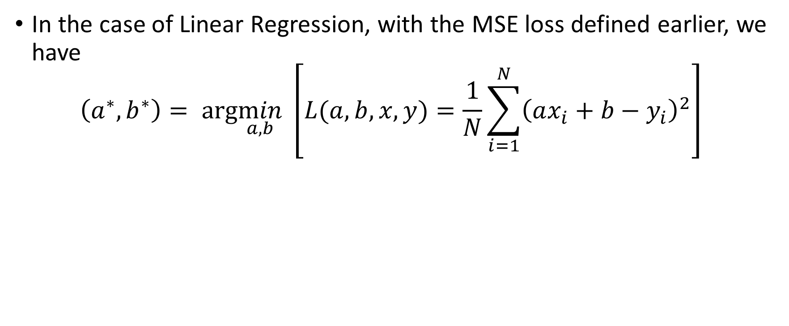
GD in Linear Regression
In the case of Linear Regression, with the MSE loss defined earlier, we have
$$\left(a^{∗},b^{∗}\right)= arg\min_{a,b} \left[L(a, b,x, y)=\frac{1}{N}\sum_{i=1}^{N}{{\left(ax_{i}+b−y_{i}\right)}^{2}}\right]$$

Slide 86

GD in Linear Regression
We have the following derivatives with respect to $a$ and $b$:
$$D_{a}=\frac{∂L}{∂a}= \frac{−2}{N} \sum_{i=1}^{N}{x_{i} \left(y_{i} − \left(a x_{i} + b\right)\right)}$$
$$D_{b}= \frac{∂L}{∂b} =\frac{−2}{N}\sum_{i}^{N}{y_{i} − (a x_{i} + b)}$$

Slide 87

GD in Linear Regression
The gradient descent update rules are therefore defined as
$$a←a −{αD}_{a}$$
$$a←a+\frac{2α}{N} \sum_{i=1}^{N}{x_{i} \left(y_{i} − \left(a x_{i} + b\right)\right)}$$
And
$$b←b −αD_{b}$$
$$b←b+\frac{2α}{N}\sum_{i}^{N}{y_{i} − (a x_{i} + b)}$$
With parameter 𝛼 being the learning rate for the gradient descent, a parameter to be decided manually, later.

Slide 88

GD in Linear Regression
Gradient Descent Linear Regression procedure:
We will then initialize $a$ and $b$ with some values (could be zero, random, or something else).
For a given number of iterations, we will apply the two update rules defined earlier.
(Optionally, we might decide to stop iterating, if we realize that the values of $a$ and $b$ are no longer changing. This is called early stopping, and is typically implemented by tracking the changes on each iteration and breaking if the changes are less than a threshold $δ$.)

Slide 89

Initialize a and b as you please.

Slide 90
Number of samples in dataset.

Slide 91
Two possible stopping conditions, change < delta or counter > max_count

Slide 92
Update using our GD update rules from earlier

Slide 93
Compute change on this iteration (to decide on early stopping or not)

Slide 94
Calculate new MSE value using the new parameters a and b. We also keep track of these losses for display later

Slide 95
Return trained parameters and losses evolution on each iteration

Slide 96


Slide 97


Slide 98

Checking for optimal parameters
We have generated the dataset ourselves, so we know what should be the values for a and b!

Slide 99


Slide 100

Using Sklearn for Linear regression
In practice, we never implement the linear regression model ourselves (but it is a good practice to try it at least once!)
It is often faster to rely on the sklearn library and use the LinearRegression object!

Slide 101

Predicting using Sklearn Linear regression
After training, it is also good practice to check if the predictor makes sense, by asking it to predict the price of an apartment it has never seen before.
Confirm the value manually, if possible.

